Slide 1
Overview
Here are instructions to make your video presentation stand out in 3 easy steps:
Step 1: Prepare the presentation
Step 2: Record your lecture

Slide 2

Environment
Select a room or place where you will NOT be distracted while you record. Try to avoid any sound distractions in the room where you record; avoid background music, sounds from roads, sounds from other rooms. Also turn off the sound and notifications on your phone and computer.
On Windows 10 go to ‘Focus Assist’ and turn it to ‘alarms only’ for the recording.

Slide 3
Backdrop & Attire
Try to create a professional atmosphere.
The easiest way is to have all white background which usually means you need to find a spot with a white wall and record there.
A nice bookcase in the background can also work well.
Although casual dress code is standard in the conference community, please keep in mind that appearance affects the presentation effectiveness.

Slide 4

Lighting
When you record, your light source should be in front of you.
Watch out for a daylight window streaming in light, or an overhead fixture that may be behind you.
The best light source for recording is indirect natural light so if it is possible, record facing a window.
General rules for artificial light sources:
You do not want the light in the camera frame.
The light should not be too close to your face.

Slide 5
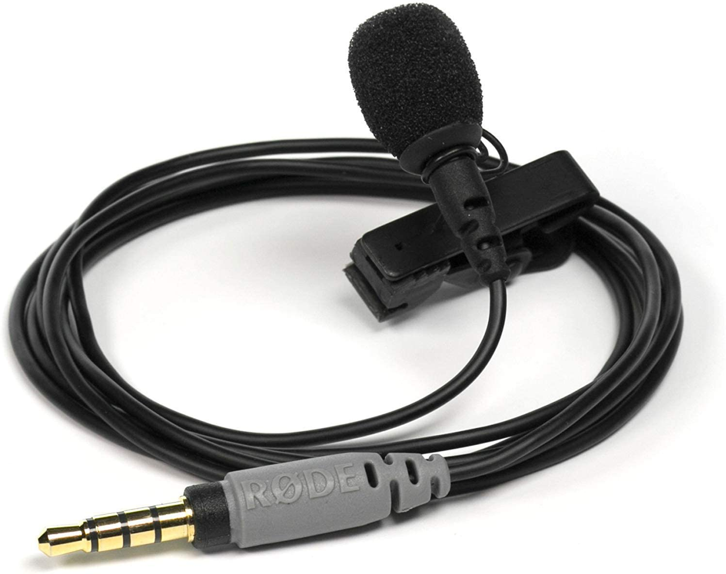
Audio
Having a dedicated microphone will make you sound a thousand times better. That’s why every presenter on TV uses a microphone of some kind.
If possible, please do NOT use the built-in Laptop Microphone!
You do NOT need to buy an expensive microphone. Any headset microphone, USB microphone or Lavalier mic will work.
Here’s an example of one (of many options) available on Amazon inexpensively https://www.amazon.com/dp/B07Z1G6K8G

Slide 6
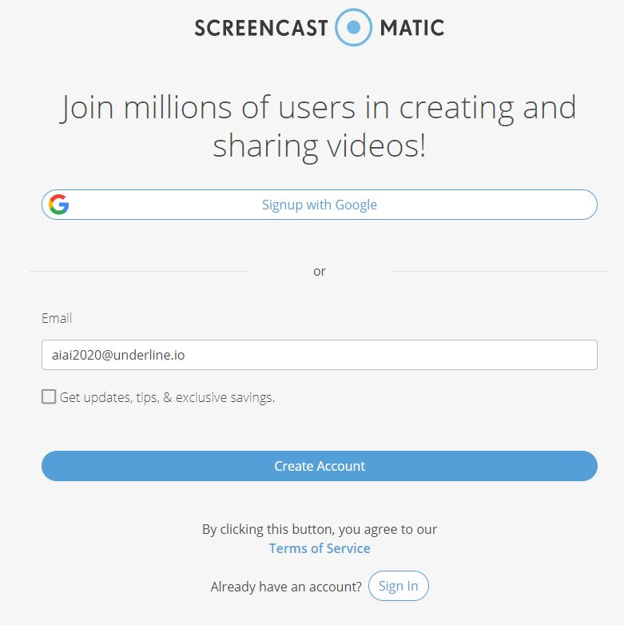
1. Download the Software & Record
Watch the “how to” video first:
https://www.youtube.com/watch?v=SJEcbkDfq-Y
Alternative “how to” video for those who can not access Youtube:
https://underline.vids.io/videos/ac9cd7bc1c1ee5c625/remote-recording-instructions-june-2020-mp4
After you view the video, access the Screencastomatic recording app on this link:
https://screencast-o-matic.com/register?ph=cYewir6zd
Important: Please use the above link install Screencast-o-matic. This will give you access to pro editing features and will store your video on our server.
We realize the fact that someone else from your team might do the recording. Please share the above link with them.

Slide 7
FAQ Information
Q: Do I have to use Screencast-o-matic?
A: It is not necessary to record with the recommended software (Screencast-o-matic). If you are already used to a preferred recording software you are welcome to use it. In this case please attach your recording to the form provided in the instructions. Files of up to 1GB can be attached to the form. Please export the video to any of the major formats like mp4, avi, mov or m4v.
Q: When I click on the "Launch Recorder" a download was initiated. It wasn't a web recorder.
A: Yes, small recorder file needs to be downloaded. It's 300kb file. It actually records on your local machine for the
quality reasons / so we're not dependent on someone’s internet connection
Q: Is there a limitation is screen size. For example, my screen is 1440p. Does that matter? Is it ok to record in 4k?
A: No limitations for recording. It can be recorded in 4k. However broadcast quality on Underline is max full HD / 1920p
Q: Is there a preference for where the webcam is during the presentation? bottom right? Top right?
A: No preference, can be moved, it's in bottom right by default so that's what's usually used
Q: Is it ok for the authors to use the drawing tools? Does that normally work well?
A: Yes, if they want to. They can easily add this also after the recording (editor is included)
Q: Is there a way to adjust the webcam size. I can only seem to get full screen.
A: You can adjust the size and position after you recorded, in the editor.
** Screencast-o-matic does not work on Linux systems. In case that you are using Linux we recommend recording with OBS (https://obsproject.com/). Contact us for help if you are recording on Linux.

